Slide 1
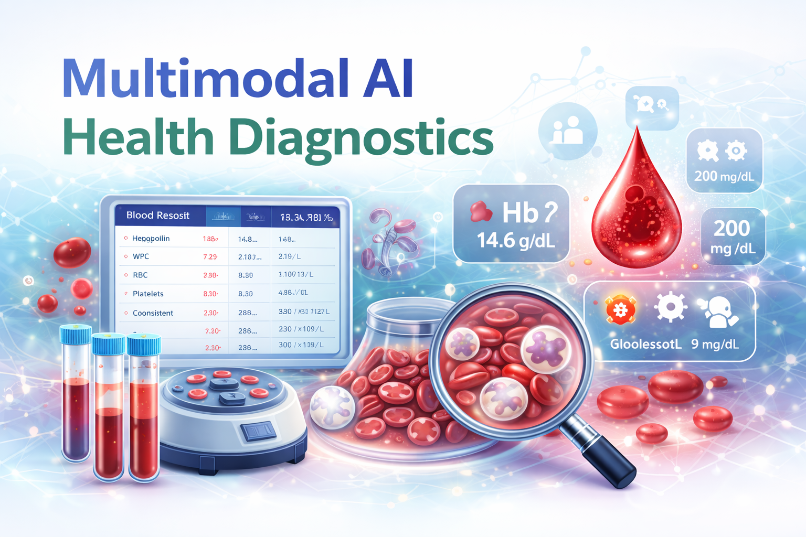
Presented by : Suhani Gosain

Slide 2

INTRODUCTION
With the increasing availability of digital healthcare data, there is a growing need for intelligent systems that can interpret medical information quickly and accurately. Blood reports provide essential insights into a person’s health, but the medical terminology and numerical parameters can be difficult for non-experts to understand.
This project introduces a multimodal AI-based diagnostic assistant that automatically analyzes blood reports and converts complex medical data into simple, meaningful insights. The system aims to make healthcare information more accessible and support early detection of potential health issues.

Slide 3
Project Overview & Objectives
Project Overview: The proposed system is an AI-powered platform that processes blood reports and provides automated interpretation along with personalized health suggestions.
Objectives:
Extract medical parameters from reports
Detect abnormal values using AI
Identify patterns indicating health risks
Generate personalized recommendations
Present results in an easy-to-understand format

Slide 4
Problem Statement
Blood reports contain complex medical indicators
Patients often struggle to interpret results
Manual interpretation can be time-consuming
Lack of quick and personalized feedback
👉 This highlights the need for an intelligent automated diagnostic system.

Slide 5
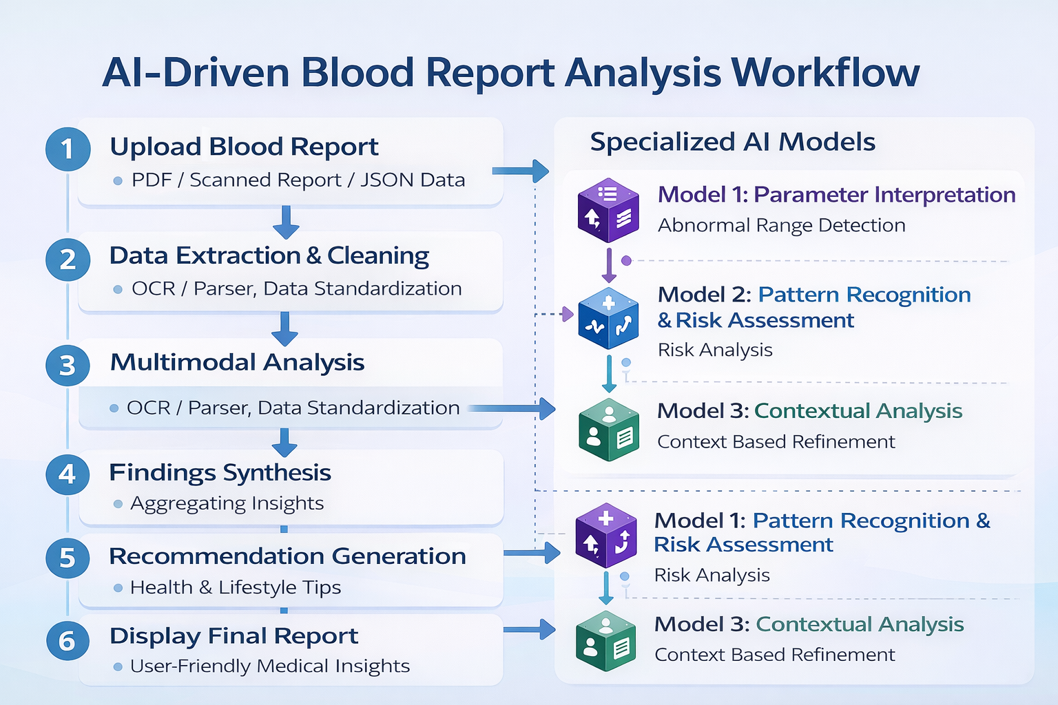
System Workflow

Slide 6
Multimodal AI Approach
The proposed system follows a multimodal AI strategy, where multiple specialized models work together to analyze the blood report from different perspectives. This approach improves accuracy, reliability, and depth of insights compared to a single-model system.
Model 1 — Parameter Interpretation
Compares each blood parameter with standard reference ranges
Classifies values as Normal, High, Low, or Borderline
Provides the first level of diagnostic insight
Model 2 — Pattern Recognition & Risk Assessment
Analyzes relationships between multiple parameters
Identifies patterns indicating potential health risks (e.g., lipid profile imbalance, anemia indicators)
Calculates basic risk indicators
Model 3 — Contextual Analysis
Uses additional user information such as age, gender, and medical history (if available)
Refines interpretation and risk assessment
Enables personalized insights

Slide 7
Advantages & Limitations
Advantages
Fast and automated analysis
Improves accessibility of medical insights
Supports preventive healthcare
Reduces manual effort
Limitations
Not a replacement for professional diagnosis
Accuracy depends on report quality
Limited integration with full medical history

Slide 8
Milestones
MILESTONE 1
MILESTONE 2
Work Done
Implemented report upload functionality
Extracted parameters using OCR techniques
Cleaned and standardized extracted data
Classified values into Normal / High / Low
Datasets & Reference Sources
World Health Organization — clinical reference ranges
Centers for Disease Control and Prevention — medical guidelines
Kaggle — sample blood report datasets
Work Done
Developed model to analyze parameter relationships
Calculated basic health risk indicators
Integrated demographic context (age/gender)

Slide 9
Milestones
MILESTONE 3
MILESTONE 4
Work Done
Combined outputs of multiple models
Generated clear summary of findings
Provided personalized health suggestions
Work Done
Integrated all modules into a single pipeline
Generated final user-friendly report
Added medical disclaimer
Performed end-to-end testing

Slide 10
Results and Conclusion:
The system successfully:
Reads and interprets blood reports automatically
Highlights abnormal parameters
Identifies potential health risks
Generates personalized lifestyle suggestions
The output is presented as a structured and easy-to-understand report.
This project demonstrates how multimodal AI can enhance healthcare diagnostics by automating blood report interpretation and providing meaningful insights.
The system improves understanding of medical data and has strong potential to support early detection and preventive healthcare practices.

